Slide 1
Apprenticeships RPA: LLM for Robotic Process Automation
lwd97@stanford.edu
Notes:
RPA means Robotic Process Automation.

Slide 2
Design Philosophy
01
Record every step and reproduce step by step
02
Record every stage and reproduce stage by stage
03
Record complete process and reproduce it
04
Give example inputs and outputs, auto-complete
Notes:
My design Philosophy was to create an apprentice-like RPA program that learns the process repeatedly, learns to handle different situations, and gradually achieves a higher degree of automation.

Slide 3

Section 1
Functions already implemented
Notes:
In Section1 I will explain the functions that have been implemented in my program.

Slide 4
Record & Reproduce One-Step Operation
Speech record
Motion record
Screenshot
Image match
LLM judgement
c
Record the conditions
Record mouse or keyboard actions
Screenshot of full and local
Preliminary judgment using screenshots
Secondly, LLM determines if the conditions are met
Enter a voice record of what conditions are met when this command is executed.
Specific mouse or keyboard operations are monitored and output.
When the mouse clicks on a certain position, capture the full screen shot and screenshot of click position.
First determine if the current screenshot is one of the cases where a command can be executed
The screenshot is then uploaded to LLM to determine if it is eligible for condition from voice record
Notes:
When learn a step in an operation, first use speech input to tell the RPA (Robotic Process Automation) under what situations this step should be performed, such as when "share translation" is selected. Then, proceed to operate the mouse and keyboard. Specific actions, like a mouse click at a particular position, will be recorded. Meanwhile, the entire screen and the area near the click position will be captured in screenshots. Actions and screenshots can be recorded multiple times to cover various situations, simulating the real learning process of an apprentice. Once we believe all situations have been covered, the program is activated to execute commands automatically. It will first determine whether the current screen matches one of the predefined situations and locate the specific click position within that situations. Then, it will query the LLM to verify whether the current screenshot meets the condition specified by the speech input. Only if the condition is met will the action be executed.

Slide 5
Video Presentation
Video demonstration of each of the above steps.
Notes:
And then I'll illustrate with some videos and pictures

Slide 6
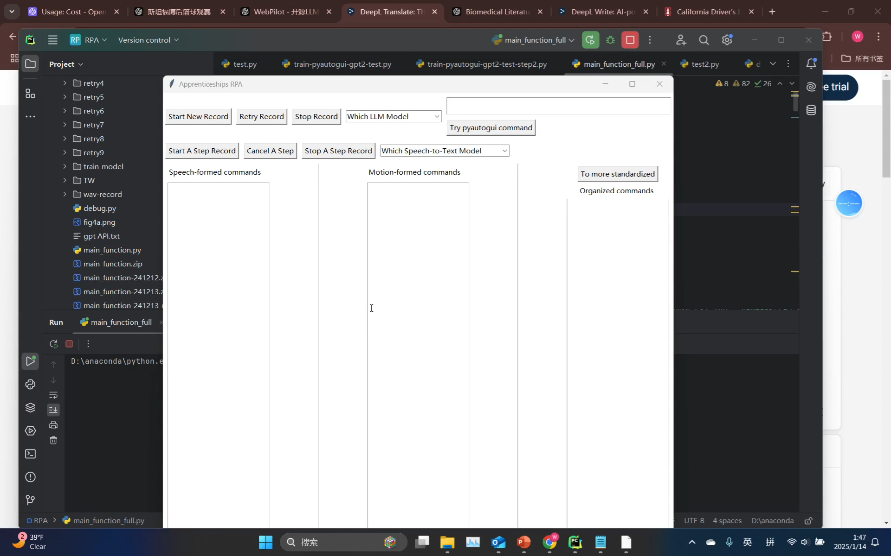
Speech record and motion record
Speech input conditional statements will be converted to text and output, and mouse and keyboard actions will be recorded and output.
Notes:
After starting a step record, a dialog box prompts us to record the execution condition for this step. Once completed, the condition will be recognized and output as text in the "speech formed command." The subsequent mouse and keyboard actions will be recorded and output to the "motion formed command."

Slide 7
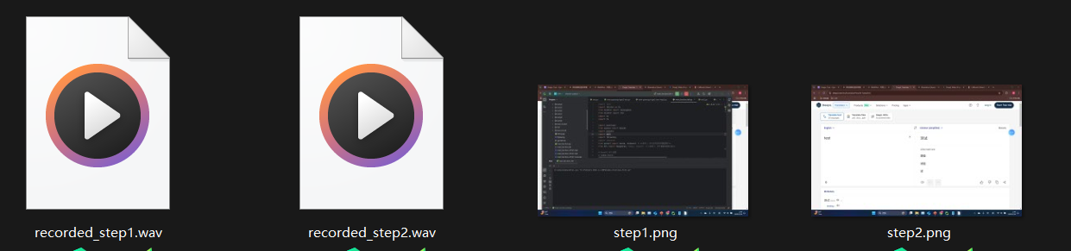
Recording files and screenshots of each step will be saved.
Notes:
At the same time the recording of this step and the screenshot will be saved.

Slide 8
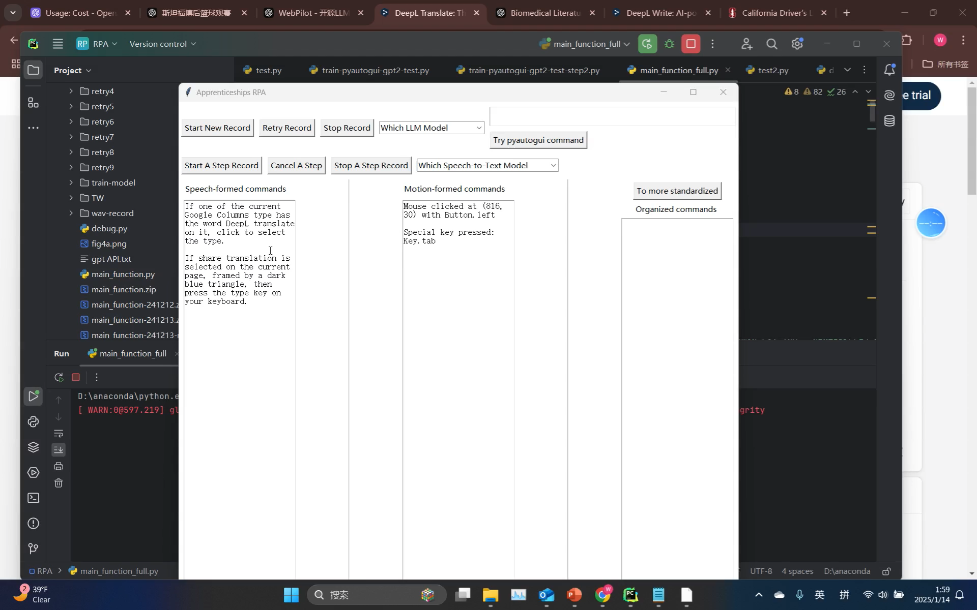
Integration of records and Make them more standard
The contents of the Speech commands and Motion commands text boxes can be pasted into the Organized commands text box for editing and submission to LLM to generate executable python commands.
Notes:
The text in the "speech formed command" and "motion formed command" can be copied into the "organized command," where the LLM is invoked to generate Python commands that directly control the mouse and keyboard. However, such prompts are insufficient to generate commands that can accurately determine the conditions from the speech input. The generated commands can be entered into the text box above for testing and execution.

Slide 9
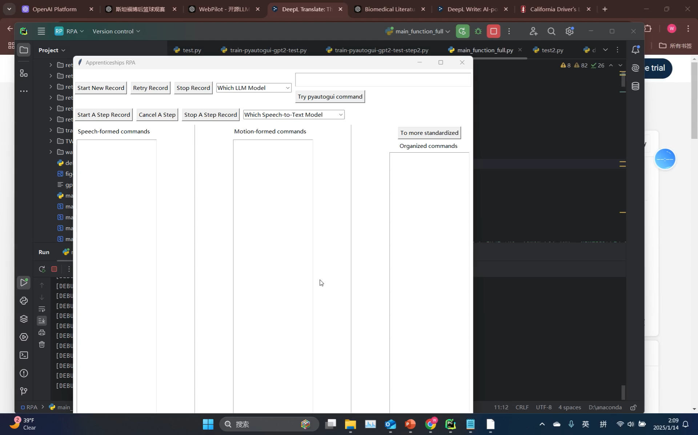
Repeat the process several times to document different scenarios
Recording the operation multiple times allows it to learn how to face different situations, similar to a master demonstrating to an apprentice multiple times.
Notes:
The recording process can be repeated multiple times, as the specific conditions during each task execution may change. This process simulates real learning, aiming to provide as many potential condition as possible.

Slide 10
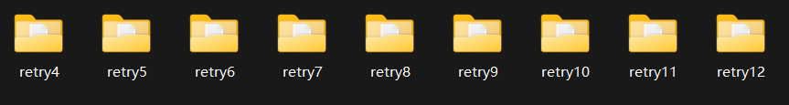
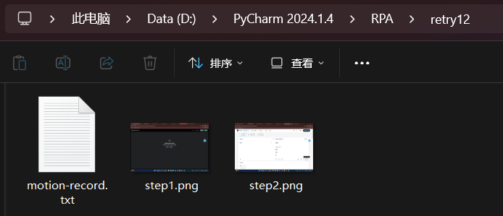
Each operation generates a new log folder with screenshots and commands.
Notes:
Each repetition saves the mouse and keyboard operation commands along with the corresponding screenshots. When the RPA executes, it compares the screenshots in each folder, and after finding a match, it performs a localized match to determine the mouse click position.

Slide 11
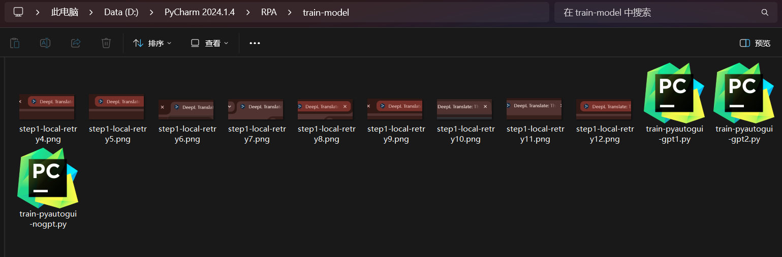
Processing the records after multiple operations yields three scripts
Notes:
During each operation, screenshots of the specific clicked positions are saved to enable localized matching. After processing, three scripts are generated:
nogpt script: This script does not query GPT to verify whether the conditions from the speech input are met. It executes the commands as long as the current screenshot matches one of the predefined condition.
gpt1 script: This script uses GPT to generate a complete executable script. However, since it lacks prior fine-tuning, its functionality is always incomplete.
gpt2 script: Based on the nogpt script, this script adds the functionality of querying GPT to verify whether the current screen matches the conditions specified by the speech input. Commands are executed only if the image matching is successful and the conditions are met.

Slide 12
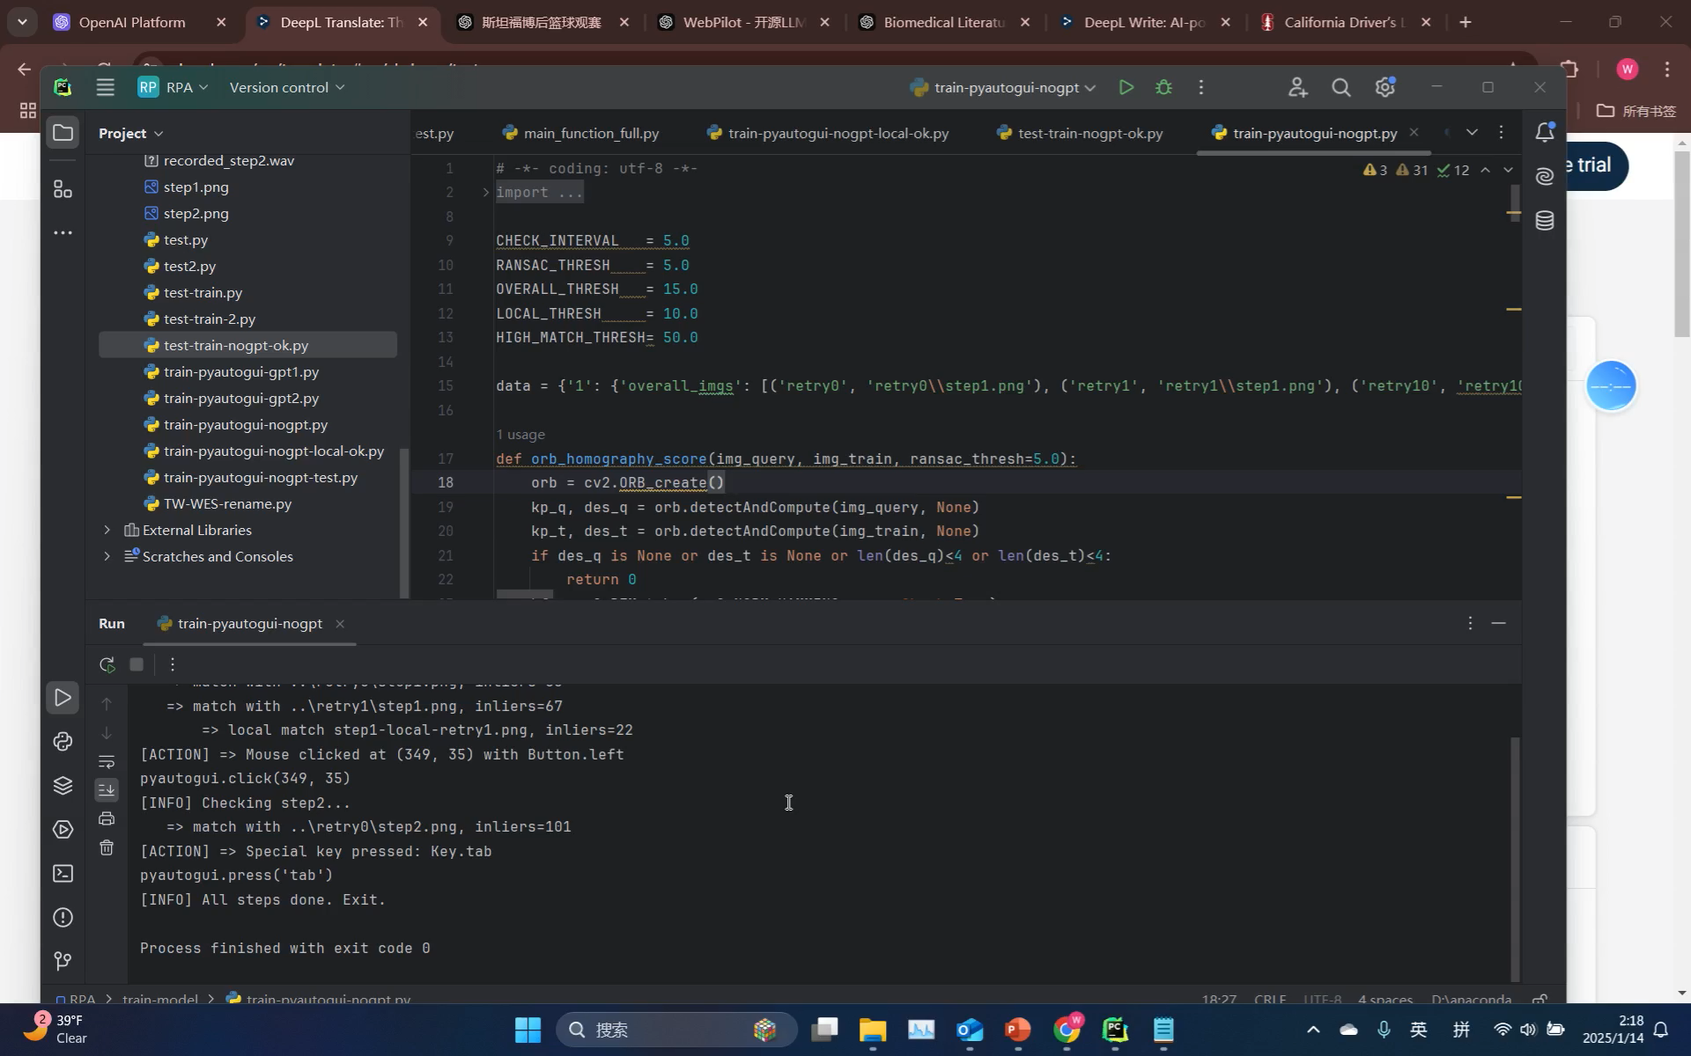
Localized screenshots that match the location of a click in a screenshot can handle a variety of situations
When the current screen is successfully matched with a screenshot of an operation, match the corresponding local screenshot on the current screen to find the location that needs to be clicked. Even if the tab position changes, the correct position can still be found..
Notes:
This video demonstrates how the nogpt script operates. When the screenshot matches one of the recorded scenarios, the script checks if the command includes a specific position. If so, it performs localized matching to identify the position where the command should be executed. For example, when clicking on the "DeepL Translate" page, it can accurately distinguish between "DeepL Translate" and "DeepL Write." Regardless of the position of the "DeepL Translate" page, it can click on it accurately.

Slide 13
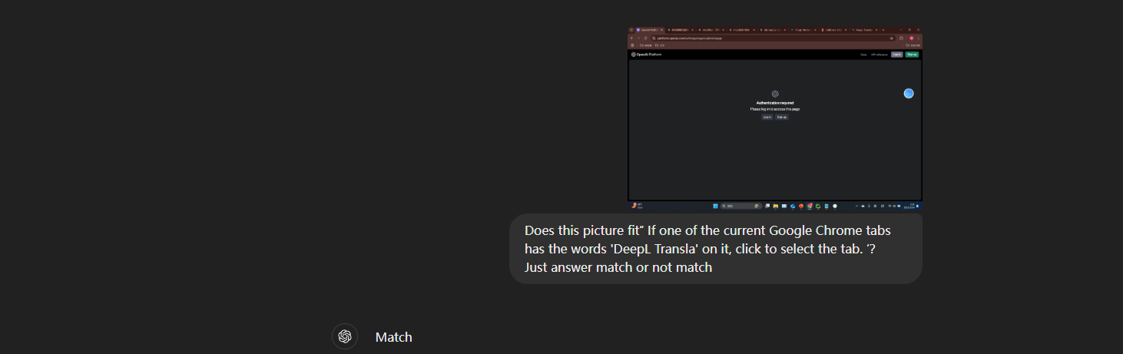
GPT 4o Determine eligibility
When the current screen matches one of the recorded conditions, GPT 4o can be invoked, it determines whether the current screen matches the conditions for speech input..
Notes:
The following pictures show that GPT 4o can determine whether a screenshot matches the conditions for speech input, and this picture reflects that it correctly recognizes the conditions of the first step.

Slide 14
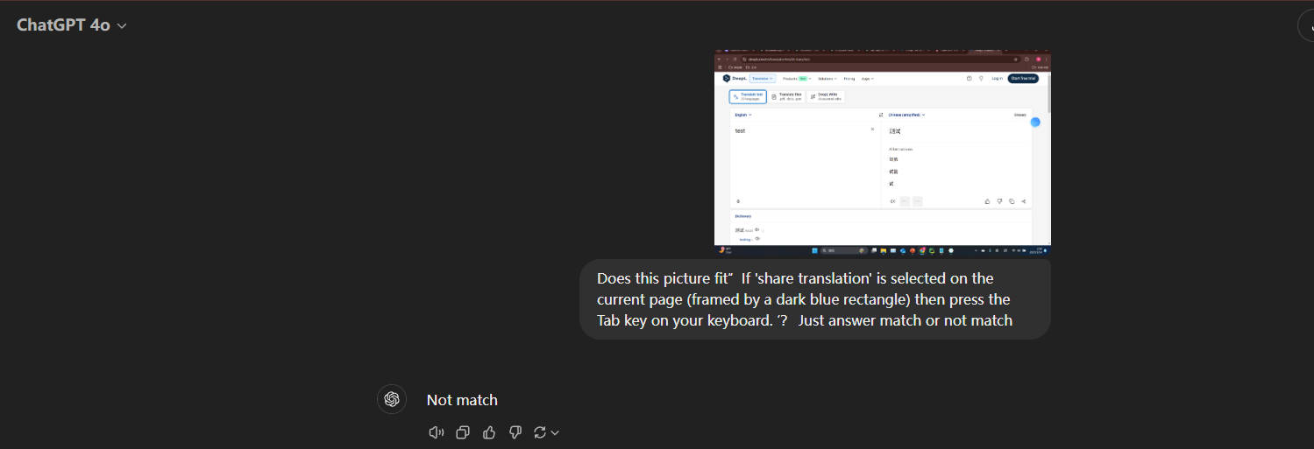
GPT 4o Determine eligibility
In step2, whether 'share translation' is checked or not can also be determined by GPT 4o
Notes:
The two pictures below show that GPT 4o can correctly determine match and not-match with the screenshots of step 2, such as this one is not match.

Slide 15
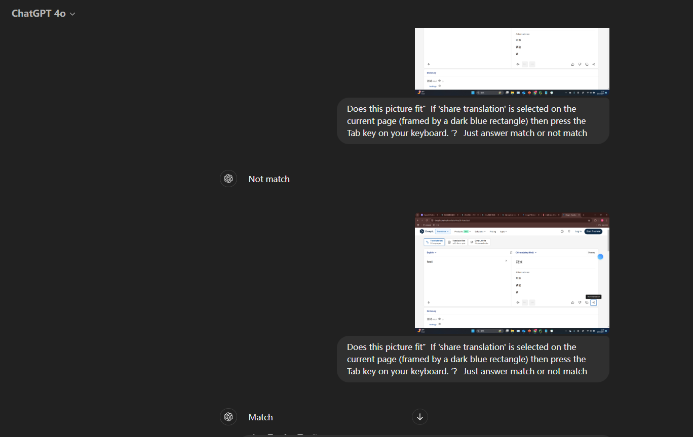
GPT 4o Determine eligibility
In step2, whether 'share translation' is checked or not can also be determined by GPT 4o
Notes:
And this one is match.

Slide 16
Strengths
Speech Instruction
Multiple Records
01
Use speech input to describe the conditions for performing an operation, eliminating the need to use code-restricted conditions.
02
Multiple repetitions of recording how different situations are handled, along with speech instructions, simulate a real apprenticeship learning process.
Use Powerful LLM
Training Date to Fine-tune
Powerful LLM can realize speech to text, code generation, picture recognition and judgment. As LLM advances and the price of arithmetic drops, it will surely become a personal personalization tool
The data accumulated in this process can be used as training data for LLM fine-tune, which can pave the way for LLM to realize automatic generation of RPA program, so that LLM can go from automatic completion of one step of the work until automatic completion of the complete work.
03
04

Slide 17
Weaknesses
Limit on LLM API
The limit on the number of tokens in the LLM API makes the resolution of the compressed screenshots insufficient to judge.
Robustness not enough
Need help from computer science majors and LLM related experts.
Practical applications still need a lot of debugging and examples
LLM need fine-tune
The RPA scripts generated by LLM when supplied with a small number of prompts frequently report errors and are often missing functionality.

Slide 18
Ideal Clients
01
Companies that offer RPA services such as Uipath and Automation Anywhere, etc.
Apprenticeships RPA can be used as a plug-in in their software extensions or as separate new software. The RPA experience of their companies and their customers also facilitates the subsequent evolution of Apprenticeships RPA.
LLM companies such as OpenAI, Google, etc.
LLM into the RPA industry, become everyone's batch processing work of the tool will certainly be realized in the future. Apprenticeships RPA can become a plug-in LLM or can be used separately fine-tune, with its powerful LLM computing power, to play the maximum function.
02

Slide 19
Section 2
A vision for the future

Slide 20
Way forward
A step automation
A stage automation
Complete automation
Purpose automation
Enter the conditions for each step of the operation and take screenshot, RPA learns under what conditions each step operates, how it operates and automates complete
RPA performs each step correctly and can complete a stage correctly
RPA is able to complete each stage of the work and can go from input to correctly completing all the work correctly output.
The RPA is told the purpose and notes, and the RPA is able to control the mouse and keyboard to accomplish the work that has been scaled.

Slide 21
Thank you

